Slide 1
Introduction to UML
CS 1509

Slide 2
What is UML?
Unified Modeling Language
OMG Standard, Object Management Group
Based on work from Booch, Rumbaugh, Jacobson
UML is a modeling language to express and design documents, software
Particularly useful for OO design
Not a process, but some have been proposed using UML
Independent of implementation language

Slide 3
Why use UML
Open Standard, Graphical notation for
Specifying, visualizing, constructing, and documenting software systems
Language can be used from general initial design to very specific detailed design across the entire software development lifecycle
Increase understanding/communication of product to customers and developers
Support for diverse application areas
Support for UML in many software packages today (e.g. Rational, plugins for popular IDE’s like NetBeans, Eclipse)
Based upon experience and needs of the user community

Slide 4
Brief History
Inundated with methodologies in early 90’s
Booch, Jacobson, Yourden, Rumbaugh
Booch, Jacobson merged methods 1994
Rumbaugh joined 1995
1997 UML 1.1 from OMG includes input from others, e.g. Yourden
UML v2.0 current version

Slide 5
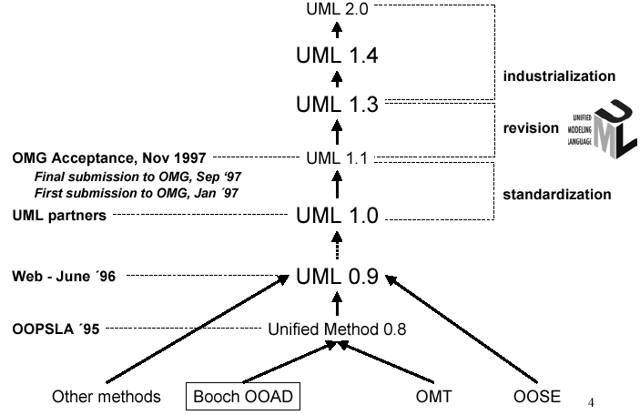
History of UML

Slide 6
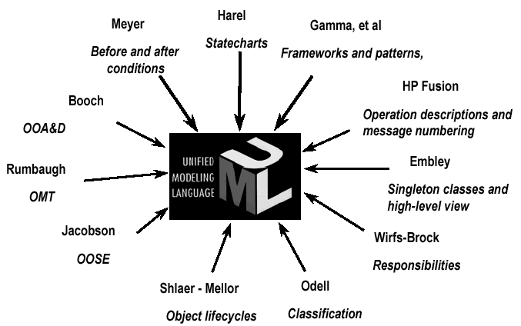
Contributions to UML

Slide 7
Systems, Models and Views
A model is an abstraction describing a subset of a system
A view depicts selected aspects of a model
A notation is a set of graphical or textual rules for depicting views
Views and models of a single system may overlap each other
Examples:
System: Aircraft
Models: Flight simulator, scale model
Views: All blueprints, electrical wiring, fuel system

Slide 8
Systems, Models and Views
Flightsimulator
Blueprints
Aircraft
Electrical
Wiring
Scale Model

Slide 9
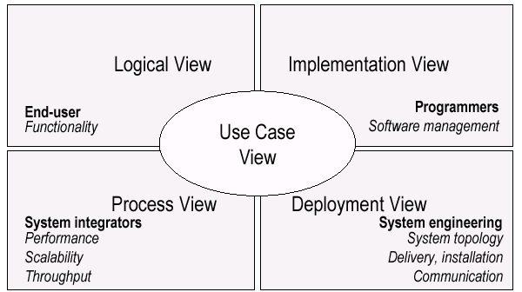
UML Models, Views, Diagrams
UML is a multi-diagrammatic language
Each diagram is a view into a model
Diagram presented from the aspect of a particular stakeholder
Provides a partial representation of the system
Is semantically consistent with other views
Example views

Slide 10
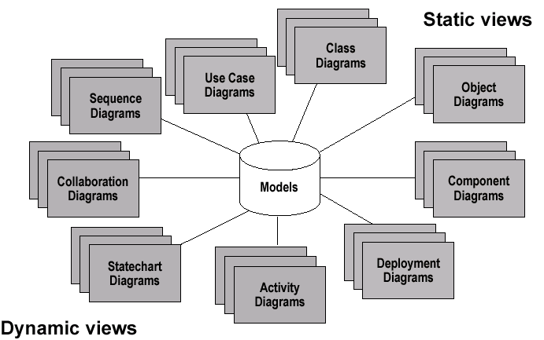
Models, Views, Diagrams

Slide 11
How Many Views?
Views should to fit the context
Not all systems require all views
Single processor: drop deployment view
Single process: drop process view
Very small program: drop implementation view
A system might need additional views
Data view, security view, …

Slide 12
UML: First Pass
You can model 80% of most problems by using about 20 % UML
We only cover the 20% here

Slide 13
Basic Modeling Steps
Use Cases
Capture requirements
Domain Model
Capture process, key classes
Design Model
Capture details and behaviors of use cases and domain objects
Add classes that do the work and define the architecture

Slide 14
UML Baseline
Use Case Diagrams
Class Diagrams
Package Diagrams
Interaction Diagrams
Sequence
Collaboration
Activity Diagrams
State Transition Diagrams
Deployment Diagrams

Slide 15
Use Case Diagrams
Used during requirements elicitation to represent external behavior
Actors represent roles, that is, a type of user of the system
Use cases represent a sequence of interaction for a type of functionality; summary of scenarios
The use case model is the set of all use cases. It is a complete description of the functionality of the system and its environment
Passenger
PurchaseTicket

Slide 16
Actors
An actor models an external entity which communicates with the system:
User
External system
Physical environment
An actor has a unique name and an optional description.
Examples:
Passenger: A person in the train
GPS satellite: Provides the system with GPS coordinates
Passenger

Slide 17
Use Case
A use case represents a class of functionality provided by the system as an event flow.
A use case consists of:
Unique name
Participating actors
Entry conditions
Flow of events
Exit conditions
Special requirements
PurchaseTicket

Slide 18
Use Case Diagram: Example
Name: Purchase ticket
Participating actor: Passenger
Entry condition:
Passenger standing in front of ticket distributor.
Passenger has sufficient money to purchase ticket.
Exit condition:
Passenger has ticket.
Event flow:
1. Passenger selects the number of zones to be traveled.
2. Distributor displays the amount due.
3. Passenger inserts money, of at least the amount due.
4. Distributor returns change.
5. Distributor issues ticket.
Anything missing?
Exceptional cases!

Slide 19
The <<extends>> Relationship
<<extends>> relationships represent exceptional or seldom invoked cases.
The exceptional event flows are factored out of the main event flow for clarity.
Use cases representing exceptional flows can extend more than one use case.
The direction of a <<extends>> relationship is to the extended use case
Passenger
PurchaseTicket
<<extends>>
<<extends>>
<<extends>>
OutOfOrder
<<extends>>
TimeOut
Cancel
NoChange

Slide 20
The <<includes>> Relationship
<<includes>> relationship represents behavior that is factored out of the use case.
<<includes>> behavior is factored out for reuse, not because it is an exception.
The direction of a <<includes>> relationship is to the using use case (unlike <<extends>> relationships).
Passenger
PurchaseMultiCard
PurchaseSingleTicket
<<includes>>
<<includes>>
<<extends>>
CollectMoney
<<extends>>
NoChange
Cancel

Slide 21
Use Cases are useful to…
Determining requirements
New use cases often generate new requirements as the system is analyzed and the design takes shape.
Communicating with clients
Their notational simplicity makes use case diagrams a good way for developers to communicate with clients.
Generating test cases
The collection of scenarios for a use case may suggest a suite of test cases for those scenarios.

Slide 22
Use Case Diagrams: Summary
Use case diagrams represent external behavior
Use case diagrams are useful as an index into the use cases
Use case descriptions provide meat of model, not the use case diagrams.
All use cases need to be described for the model to be useful.

Slide 23
Class Diagrams
Gives an overview of a system by showing its classes and the relationships among them.
Class diagrams are static
they display what interacts but not what happens when they do interact
Also shows attributes and operations of each class
Good way to describe the overall architecture of system components

Slide 24
Class Diagram Perspectives
We draw Class Diagrams under three perspectives
Conceptual
Software independent
Language independent
Specification
Focus on the interfaces of the software
Implementation
Focus on the implementation of the software

Slide 25
Classes – Not Just for Code
TariffSchedule
Table zone2price
Enumeration getZones()
Price getPrice(Zone)
Name
TariffSchedule
Attributes
Signature
zone2price
getZones()
getPrice()
Operations
TariffSchedule
A class represent a concept
A class encapsulates state (attributes) and behavior (operations).
Each attribute has a type.
Each operation has a signature.
The class name is the only mandatory information.

Slide 26
Instances
tarif_1974:TariffSchedule
zone2price = {
{‘1’, .20}, {‘2’, .40},
{‘3’, .60}}
An instance represents a phenomenon.
The name of an instance is underlined and can contain the class of the instance.
The attributes are represented with their values.

Slide 27
UML Class Notation
A class is a rectangle divided into three parts
Class name
Class attributes (i.e. data members, variables)
Class operations (i.e. methods)
Modifiers
Private: -
Public: +
Protected: #
Static: Underlined (i.e. shared among all members of the class)
Abstract class: Name in italics

Slide 28
UML Class Notation
Lines or arrows between classes indicate relationships
Association
A relationship between instances of two classes, where one class must know about the other to do its work, e.g. client communicates to server
indicated by a straight line or arrow
Aggregation
An association where one class belongs to a collection, e.g. instructor part of Faculty
Indicated by an empty diamond on the side of the collection
Composition
Strong form of Aggregation
Lifetime control; components cannot exist without the aggregate
Indicated by a solid diamond on the side of the collection
Inheritance
An inheritance link indicating one class a superclass relationship, e.g. bird is part of mammal
Indicated by triangle pointing to superclass

Slide 29

Binary Association
Binary Association: Both entities “Know About” each other
myB.service();
myA.doSomething();
Optionally, may create an Associate Class

Slide 30

Unary Association
A knows about B, but B knows nothing about A
myB.service();
Arrow points in direction
of the dependency

Slide 31

Aggregation
Aggregation is an association with a “collection-member” relationship
void doSomething() aModule.service();
Hollow diamond on
the Collection side
No sole ownership implied

Slide 32
Composition
Composition is Aggregation with:
Lifetime Control (owner controls construction, destruction)
Part object may belong to only one whole object
members[0] = new Employee();
…
delete members[0];
Filled diamond on side of the Collection

Slide 33
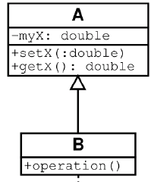
Inheritance
Standard concept of inheritance
Base Class
Derived Class
class B() extends A
…

Slide 34
UML Multiplicities
Links on associations to specify more details about the relationship
Multiplicities | Meaning
0..1 | zero or one instance. The notation n . . m indicates n to m instances.
0..* or * | no limit on the number of instances (including none).
1 | exactly one instance
1..* | at least one instance

Slide 35
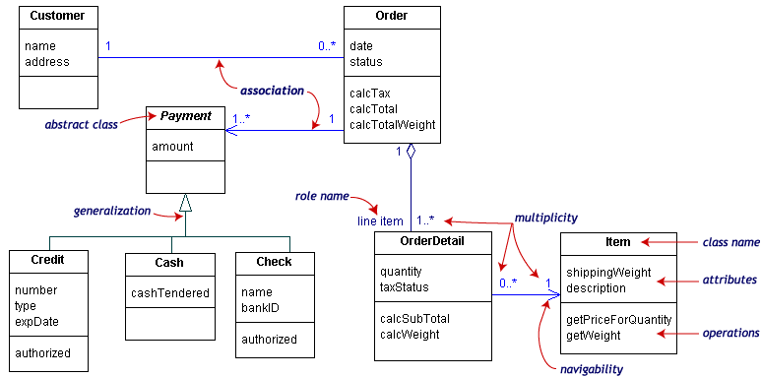
UML Class Example

Slide 36
Association Details
Can assign names to the ends of the association to give further information
Team
-
Employee
group
-
Name
-
:
string
members
:
Employee
-
individual
+
ID
:
long
#
Salary
1
:
double
-
adfaf
*
:
bool
+
getName
() :
string
+
setName
()
-
calcInternalStuff
(
in x
:
byte
,
in y
:
decimal
)

Slide 37
Static vs. Dynamic Design
Static design describes code structure and object relations
Class relations
Objects at design time
Doesn’t change
Dynamic design shows communication between objects
Similarity to class relations
Can follow sequences of events
May change depending upon execution scenario
Called Object Diagrams

Slide 38
Object Diagrams
Shows instances of Class Diagrams and links among them
An object diagram is a snapshot of the objects in a system
At a point in time
With a selected focus
Interactions – Sequence diagram
Message passing – Collaboration diagram
Operation – Deployment diagram

Slide 39
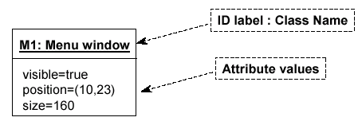
Object Diagrams
Format is
Instance name : Class name
Attributes and Values
Example:

Slide 40
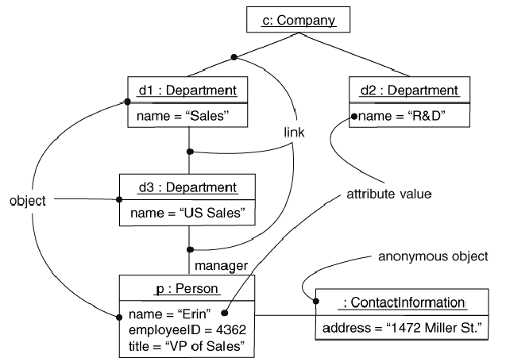
Objects and Links
Can add association type and also message type

Slide 41
Package Diagrams
To organize complex class diagrams, you can group classes into packages. A package is a collection of logically related UML elements
Notation
Packages appear as rectangles with small tabs at the top.
The package name is on the tab or inside the rectangle.
The dotted arrows are dependencies. One package depends on another if changes in the other could possibly force changes in the first.
Packages are the basic grouping construct with which you may organize UML models to increase their readability

Slide 42
Package Example
DispatcherInterface
Notification
IncidentManagement

Slide 43
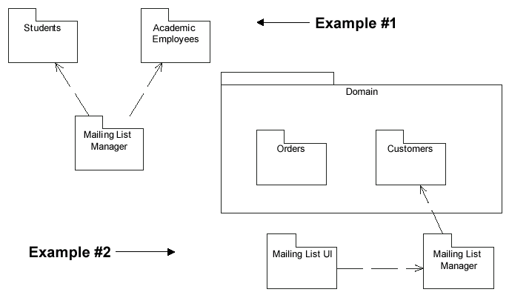
More Package Examples

Slide 44
Interaction Diagrams
Interaction diagrams are dynamic -- they describe how objects collaborate.
A Sequence Diagram:
Indicates what messages are sent and when
Time progresses from top to bottom
Objects involved are listed left to right
Messages are sent left to right between objects in sequence

Slide 45
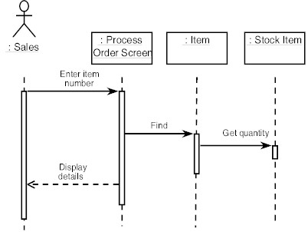
Sequence Diagram Format
Actor from
Use Case
Objects
1
Activation
2
3
4
Lifeline
Calls = Solid Lines
Returns = Dashed Lines

Slide 46
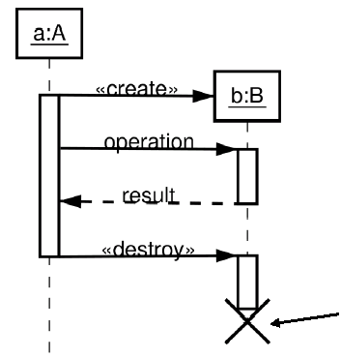
Sequence Diagram : Destruction
Shows Destruction of b
(and Construction)

Slide 47
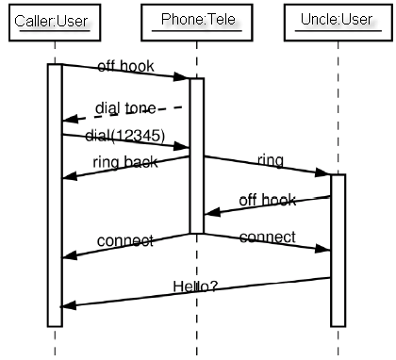
Sequence Diagram : Timing
Slanted Lines show propagation delay of messages
Good for modeling real-time systems
If messages cross this is usually problematic – race conditions

Slide 48
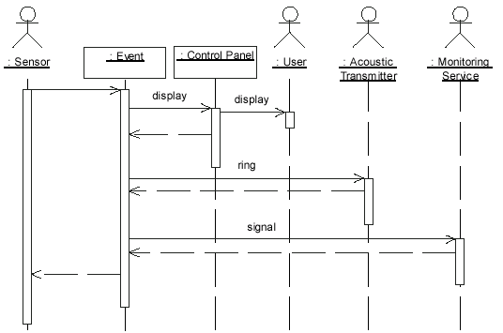
Sequence Example: Alarm System
When the alarm goes off, it rings the alarm, puts a message on the display, notifies the monitoring service

Slide 49
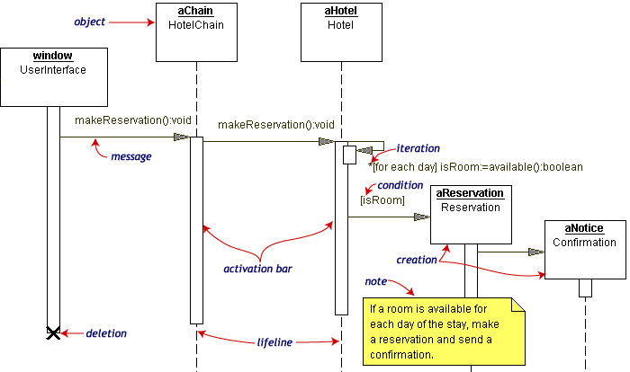
Sequence Diagram Example
Hotel Reservation

Slide 50
Collaboration Diagram
Collaboration Diagrams show similar information to sequence diagrams, except that the vertical sequence is missing. In its place are:
Object Links - solid lines between the objects that interact
On the links are Messages - arrows with one or more message name that show the direction and names of the messages sent between objects
Emphasis on static links as opposed to sequence in the sequence diagram

Slide 51
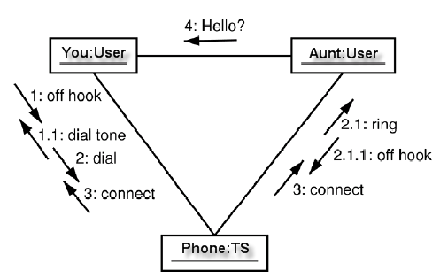
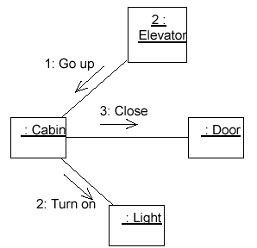
Collaboration Diagram

Slide 52
Activity Diagrams
Fancy flowchart
Displays the flow of activities involved in a single process
States
Describe what is being processed
Indicated by boxes with rounded corners
Swim lanes
Indicates which object is responsible for what activity
Branch
Transition that branch
Indicated by a diamond
Fork
Transition forking into parallel activities
Indicated by solid bars
Start and End

Slide 53
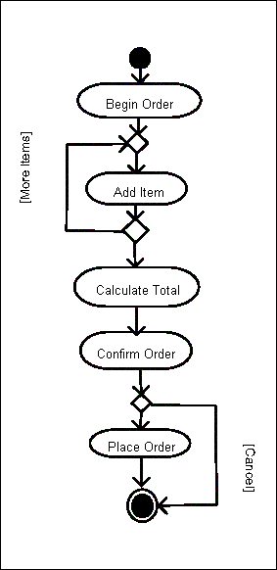
Sample Activity Diagram
Ordering System
May need multiple diagrams from other points of view

Slide 54
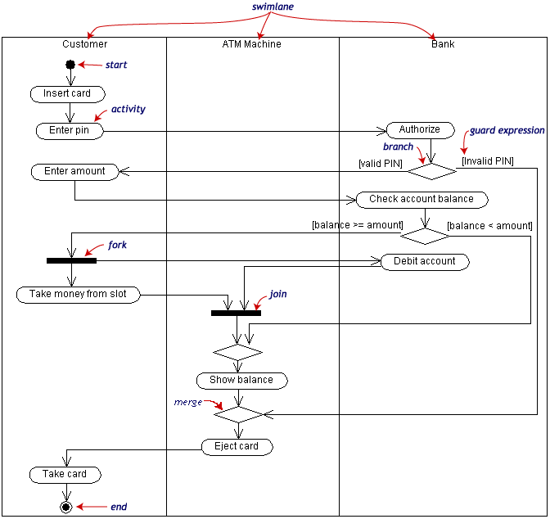
Activity Diagram Example

Slide 55
State Transition Diagrams
Fancy version of a DFA
Shows the possible states of the object and the transitions that cause a change in state
i.e. how incoming calls change the state
Notation
States are rounded rectangles
Transitions are arrows from one state to another. Events or conditions that trigger transitions are written beside the arrows.
Initial and Final States indicated by circles as in the Activity Diagram
Final state terminates the action; may have multiple final states

Slide 56
State Representation
The set of properties and values describing the object in a well defined instant are characterized by
Name
Activities (executed inside the state)
Do/ activity
Actions (executed at state entry or exit)
Entry/ action
Exit/ action
Actions executed due to an event
Event [Condition] / Action ^Send Event

Slide 57
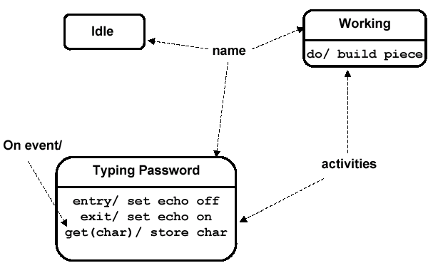
Notation for States

Slide 58
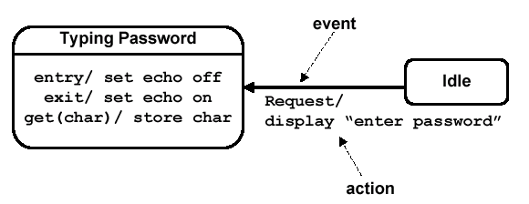
Simple Transition Example

Slide 59
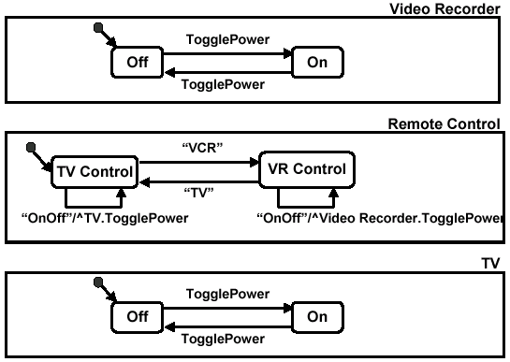
More Simple State Examples

Slide 60
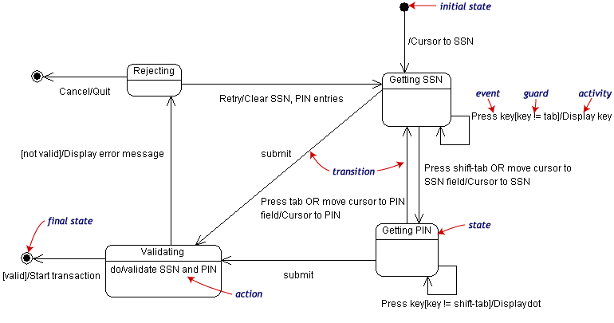
State Transition Example
Validating PIN/SSN

Slide 61
State Charts – Local Variables
State Diagrams can also store their own local variables, do processing on them
Library example counting books checked out and returned

Slide 62
Component Diagrams
Shows various components in a system and their dependencies, interfaces
Explains the structure of a system
Usually a physical collection of classes
Similar to a Package Diagram in that both are used to group elements into logical structures
With Component Diagrams all of the model elements are private with a public interface whereas Package diagrams only display public items.

Slide 63


Component Diagram Notation
Components are shown as rectangles with two tabs at the upper left
Dashed arrows indicate dependencies
Circle and solid line indicates an interface to the component

Slide 64
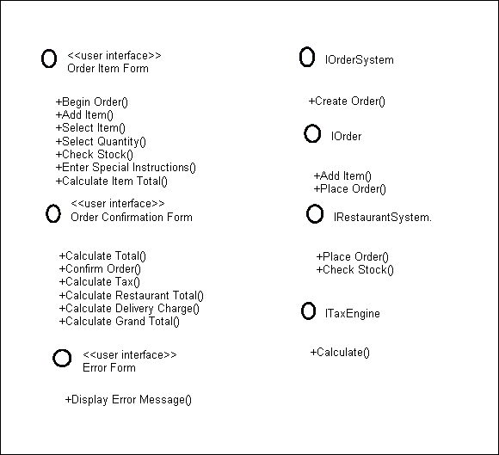
Component Example - Interfaces
Restaurant ordering system
Define interfaces first – comes from Class Diagrams

Slide 65
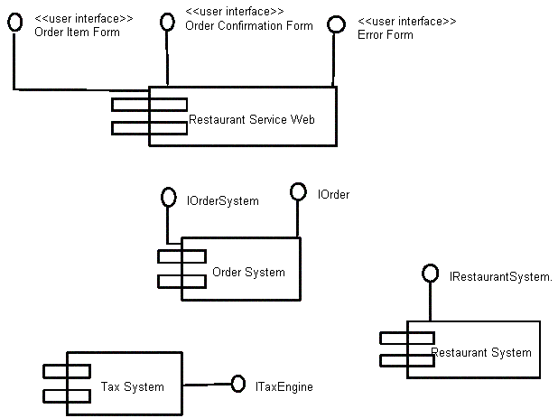
Component Example - Components
Graphical depiction of components

Slide 66
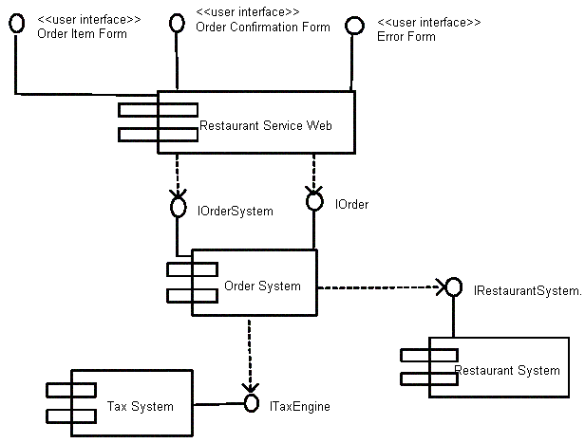
Component Example - Linking
Linking components with dependencies

Slide 67
Deployment Diagrams
Shows the physical architecture of the hardware and software of the deployed system
Nodes
Typically contain components or packages
Usually some kind of computational unit; e.g. machine or device (physical or logical)
Physical relationships among software and hardware in a delivered systems
Explains how a system interacts with the external environment

Slide 68
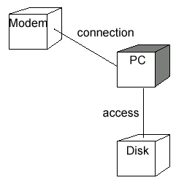
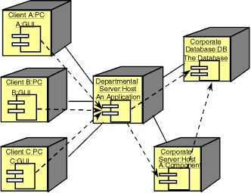
Some Deployment Examples

Slide 69
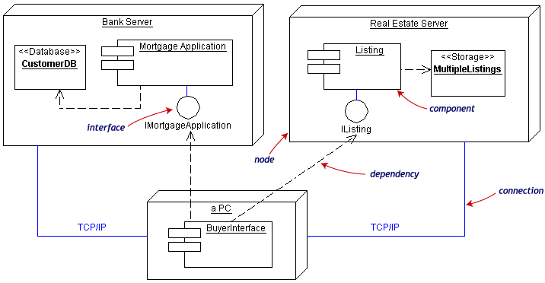
Deployment Example
Often the Component Diagram is combined with the Deployment

Slide 70
Summary and Tools
UML is a modeling language that can be used independent of development
Adopted by OMG and notation of choice for visual modeling
http://www.omg.org/uml/
Creating and modifying UML diagrams can be labor and time intensive.
Lots of tools exist to help
Tools help keep diagrams, code in sync
Repository for a complete software development project
Examples here created with TogetherSoft ControlCenter, Microsoft Visio, Tablet UML
Other tools:
Rational, Cetus, Embarcadero
See http://plg.uwaterloo.ca/~migod/uml.html for a list of tools, some free

